Slide 1


Power BI
A Business Intelligence tool

Slide 2
Power BI
Power BI is a Data Visualization and Business Intelligence tool that converts data from different data sources to interactive dashboards and BI reports.

Slide 3
Power BI
Power BI is a is a collection of components:
Power Query - For Cleaning the data
Power Pivot – creating relationship between multiple data sources
Power View – to create different type of charts
Power BI Service – to share

Slide 4
Why Power BI?
Speed
User Friendly
Eye-catching and Interactive Dashboards
Maximum Features (functions , visuals)
Cost – cheapest tool
Data connectivity – can connect to ~ 100 data sources

Slide 5
How Power BI works ?
Power BI Desktop – used to create reports
Power BI Service – used to publish the reports

Slide 6
Power BI & Tableau- A Comparison
Feature | Tableau | Power BI
Data Visualization | Tableau the main data visualization tool in the market which provides strong data visualization. | Power BI provides a strong backend data manipulation feature with access to simple visualizations.
Size of Dataset | Tableau can connect much larger datasets | 1 GB data limit in free version
Data Sources | Tableau connects to a wide range of data sources, we select the dataset first and then visualizations are used | Power BI covers most of the data sources available in Tableau. Its online version also supports direct visualization on Search Engine (Bling)

Slide 7
Power BI & Tableau- A Comparison
Feature | Tableau | Power BI
Costing | Tableau is expensive as compared to Power BI. Tableau Desktop Profession: USD70/user/month and it can connect to hundreds of data sources. | Power BI provides a free version with 1GB limit on dataset. Power BI Pro is also a cheaper solution when compared with any other BI tool Power BI Pro: USD9.99/user/month (10 GB Storage)

Slide 8
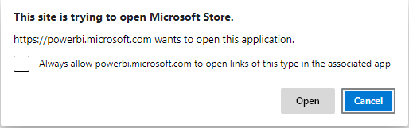
Installing Power BI (Free)
To download the latest version, use the following link:
https://powerbi.microsoft.com/en-us/downloads/
Click on download – You will be prompted to open the MS store click Open

Slide 9
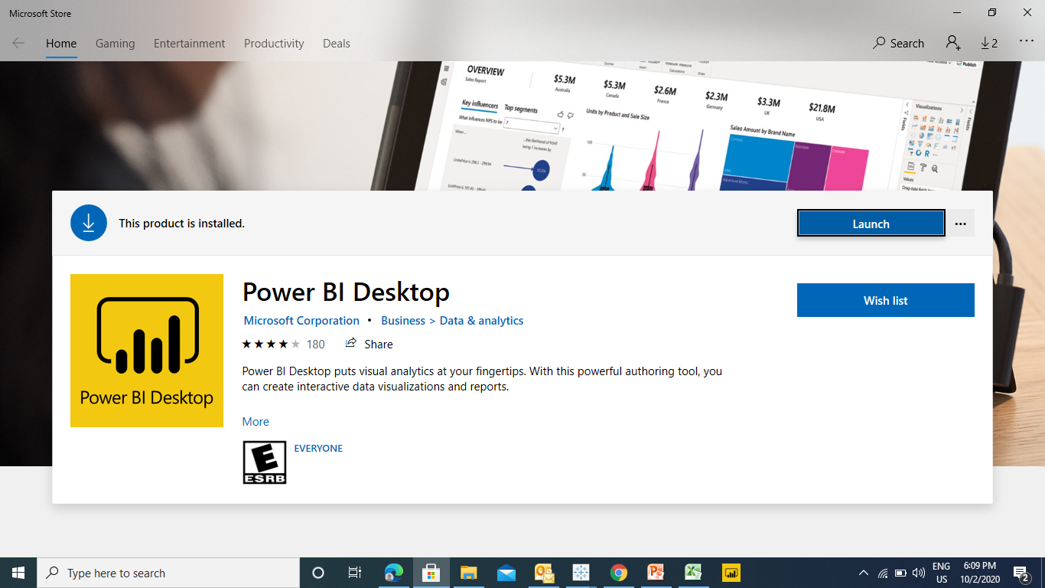
Installing Power BI (Free)
Once Downloaded you will be getting the launch button
Power Bi upgrades every month

Slide 10
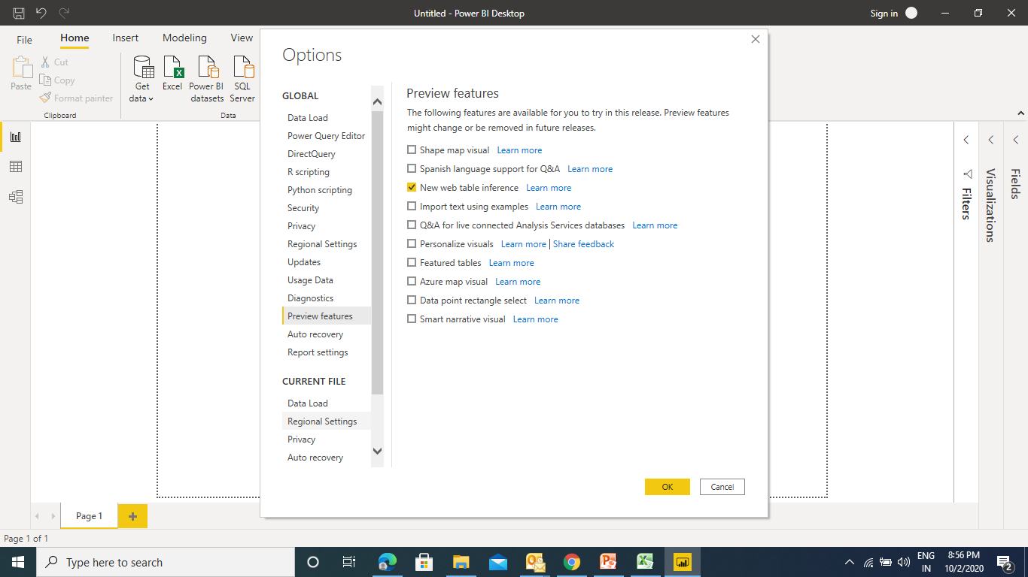
Upgrading Power BI
Use Preview Features (File -> Options) to update Power BI
Power Bi upgrades every month

Slide 11
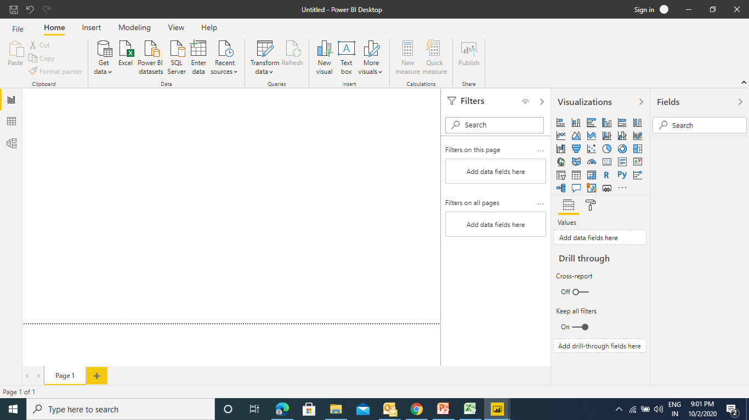

Slide 12
Three Steps in Power BI
Get the Data in Power BI− It involves locating the data and using an appropriate type of connection to read the data.
Choose the visualization − This involves selecting the chart type to be created.
Select the fields to be worked on − This involves moving the fields to the desired area.

Slide 13
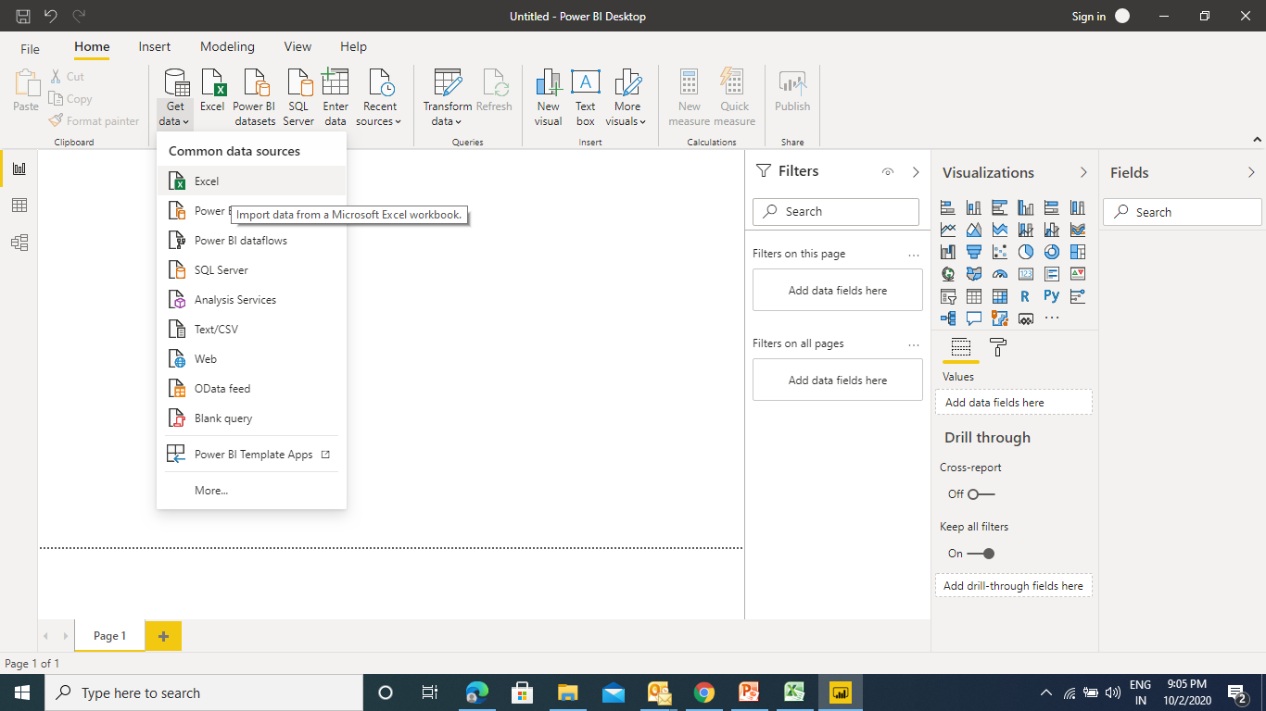
Basic Charts in Power BI
Connect to a data source − It involves locating the data and using an appropriate type of connection to read the data.
Power BI supports large range of data sources. You can click Get data and it shows you all the available data connections.

Slide 14
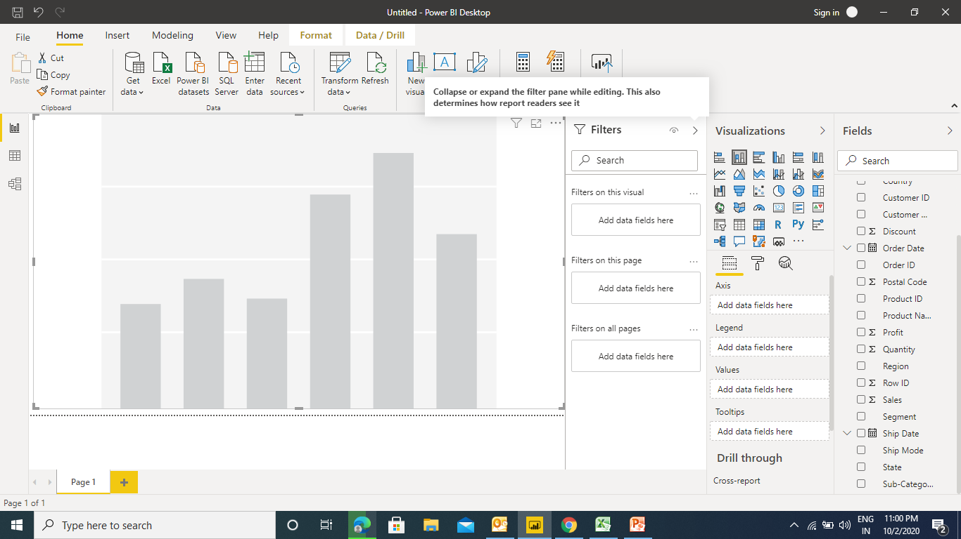
Basic Charts in Power BI
Choose the visualization − This involves selecting the chart type to be created.

Slide 15
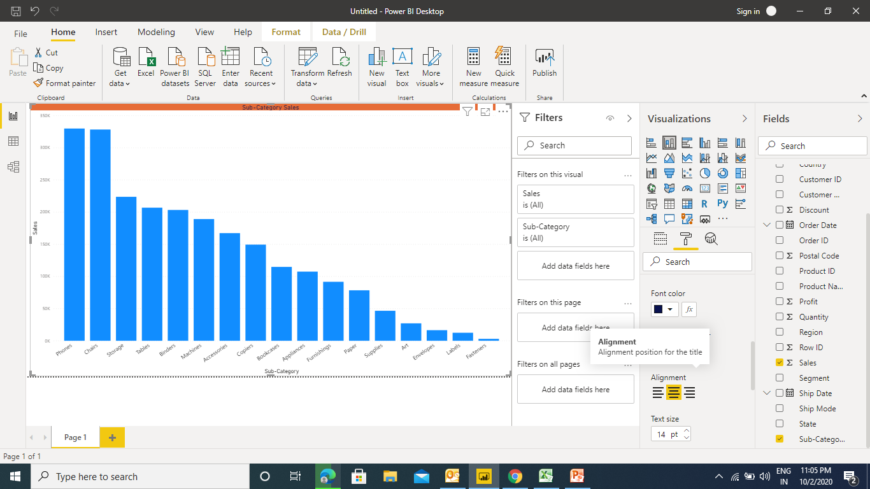
Basic Charts in Power BI – Bar Chart
Select the fields to be worked on − This involves moving the fields to the desired area.

Slide 16
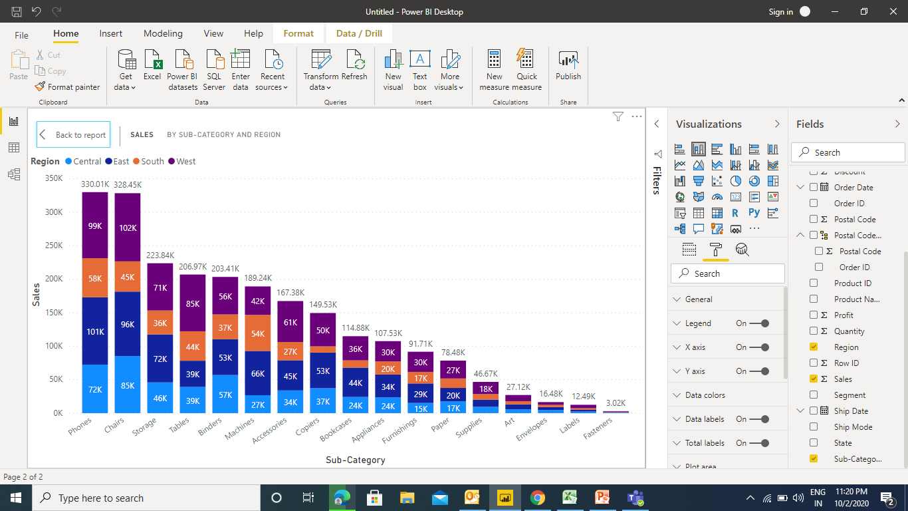
Basic Charts in Power BI – Stacked Bar Chart

Slide 17
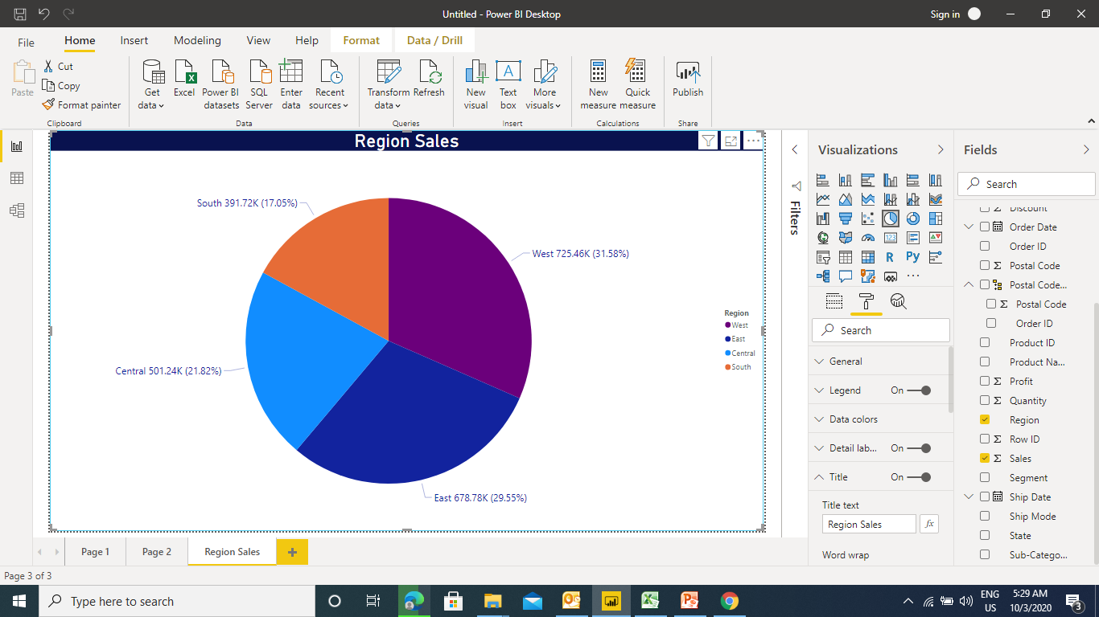
Basic Charts in Power BI – Pie Chart

Slide 18
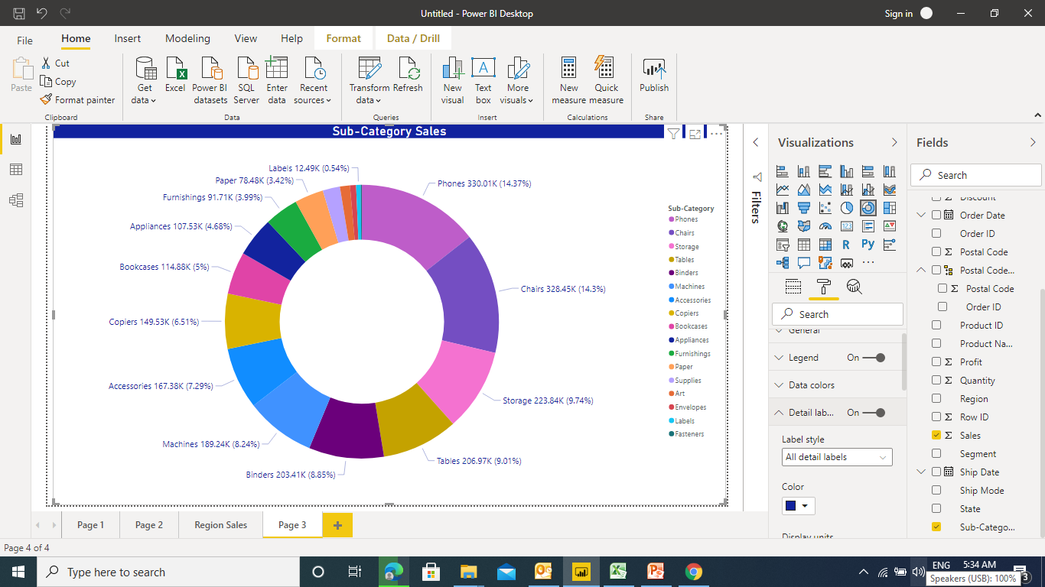
Basic Charts in Power BI – Donut Chart

Slide 19
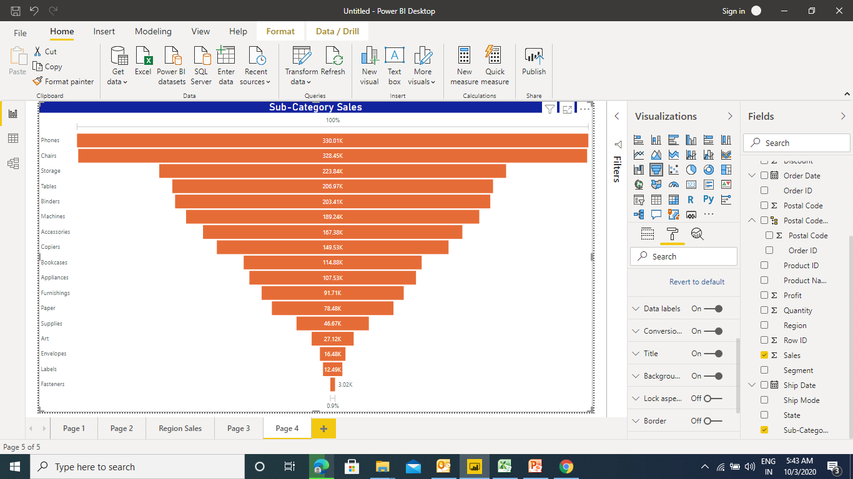
Basic Charts in Power BI – Funnel Chart

Slide 20
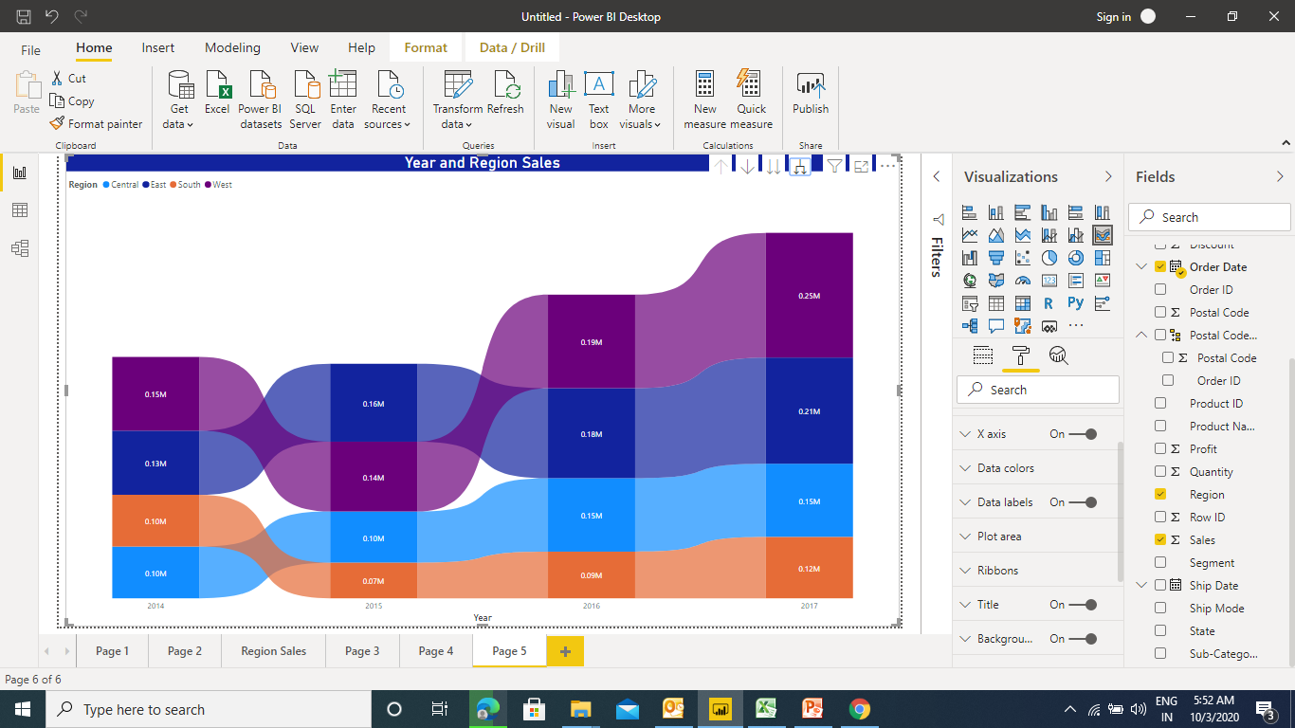
Basic Charts in Power BI – Ribbon Chart

Slide 21
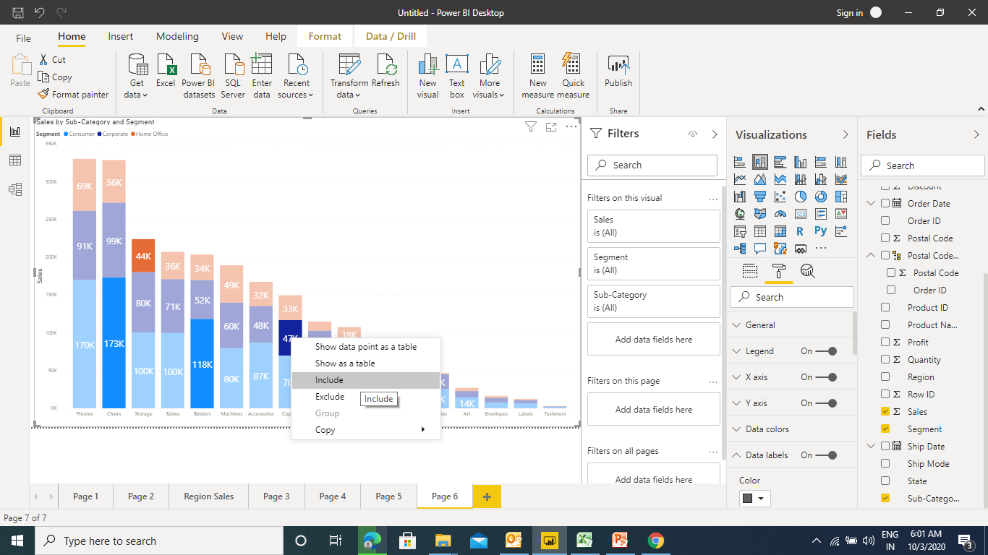
Basic Charts in Power BI – Include / Exclude
In order to focus on a specific set of points you can now select one or more points and right click to include or exclude points in your visual.
Include will filter out all points except for those you’ve chosen to include. Exclude will filter out the points you’ve chosen to exclude.

Slide 22
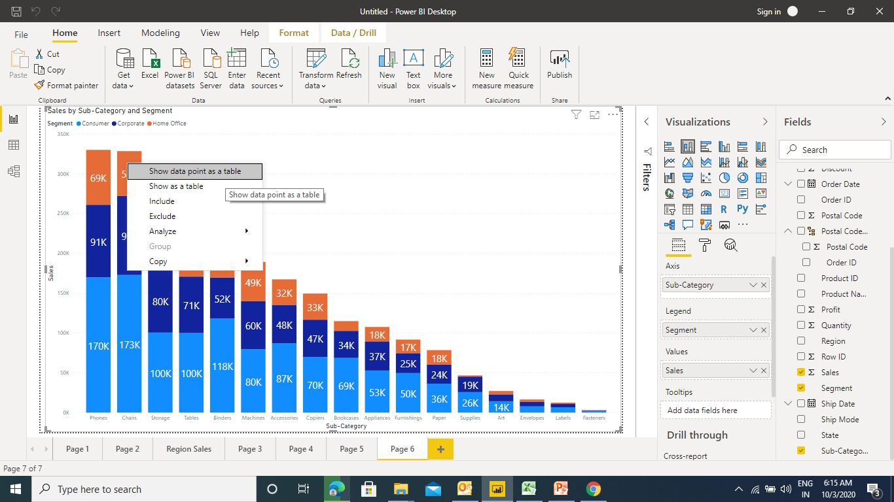
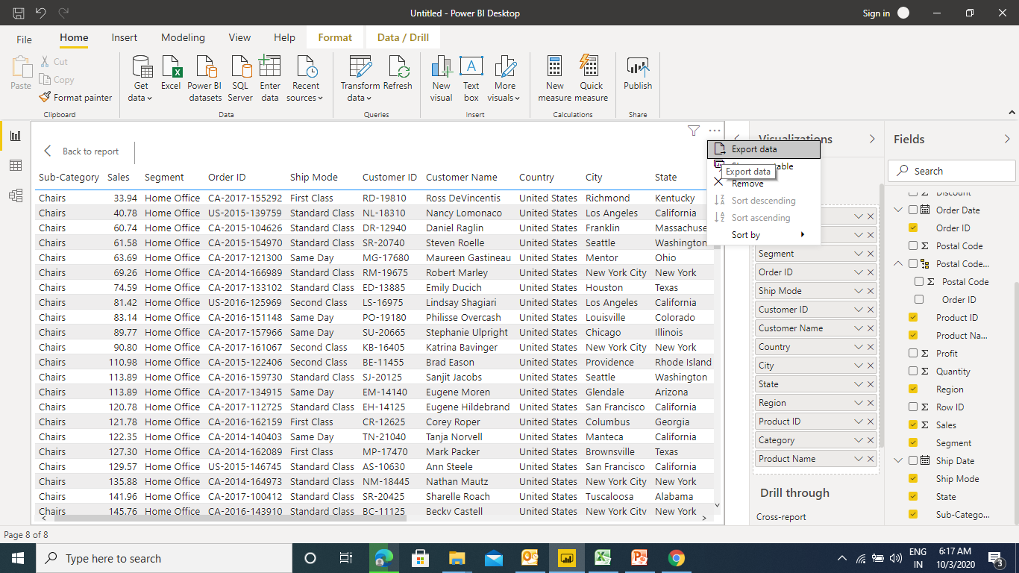
Basic Charts in Power BI – Export Data from Chart
This feature allows you to export the detailed data directly from the chart

Slide 23
Basic Charts in Power BI – Export Data from Chart
This feature allows you to export the detailed data directly from the chart

Slide 24
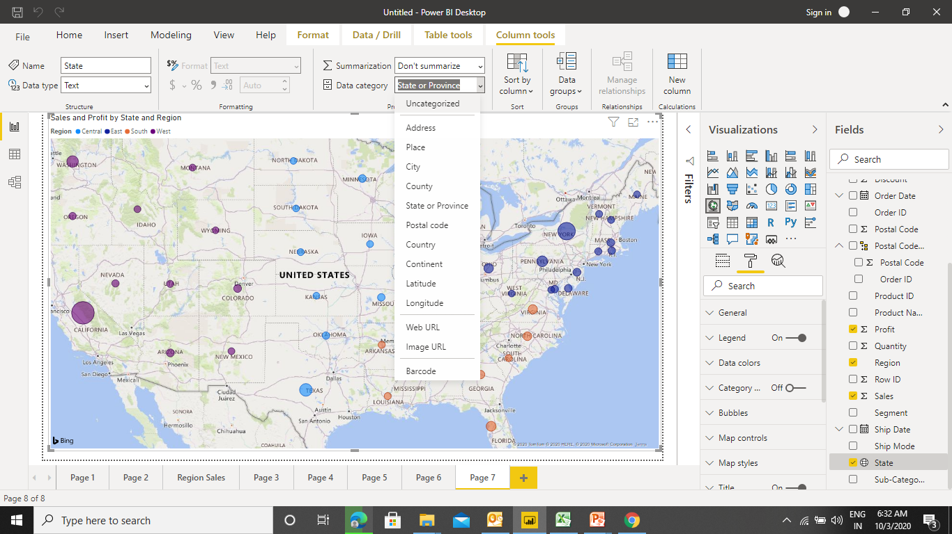
Map in Power BI
Power BI provides two types of map visualization - bubble maps and shape maps. To create a Map you need some geographical Data type such as Country , State, City , Postal code , Latitude, longitude etc..

Slide 25
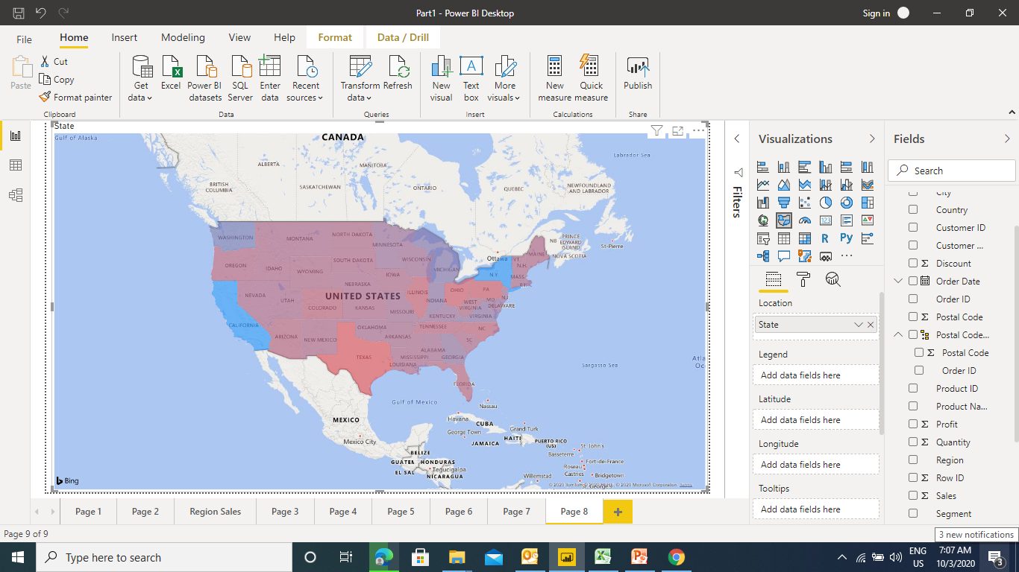
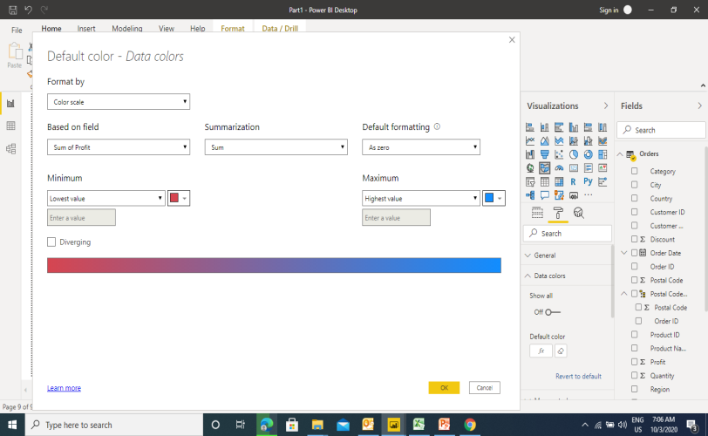
Map in Power BI - Filed Map
A filled map uses shading [from light (less-frequent/lower) to dark (more-frequent/more)] to display how a value differs in proportion across a geography or region.

Slide 26
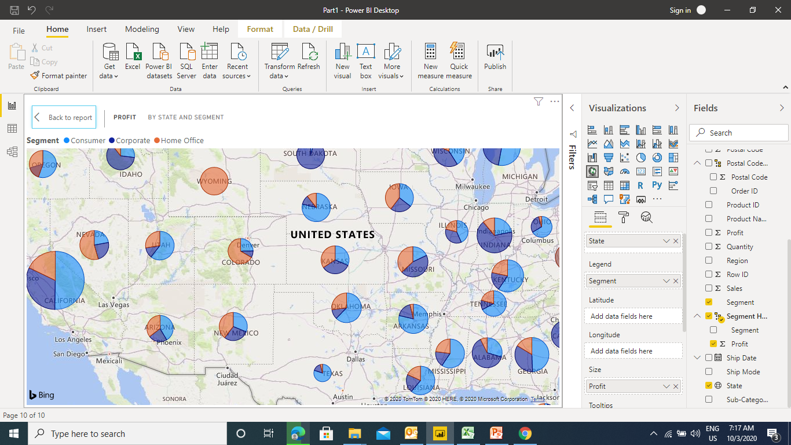
Map in Power BI - Map with Pie
It a blend of Map & Pie where no. of Pie chart are plotted on the map

Slide 27
Map in Power BI - Formatting
Map Formatting options are available under Map controls to enhance the Map
Data Colors – change the color of data bubble
Category – get the name of states
Bubbles – change size of bubble
Map Controls – Zoom in & Zoom Out Buttons
Title – Map Title
Tool Tip – format tool tip box
Map Styles – change the map background

Slide 28
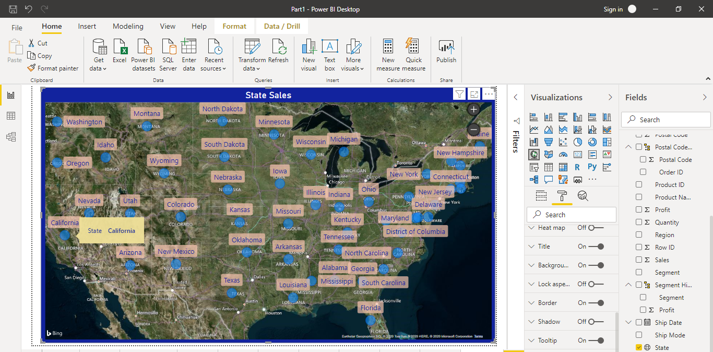
Map in Power BI - Formatting

Slide 29
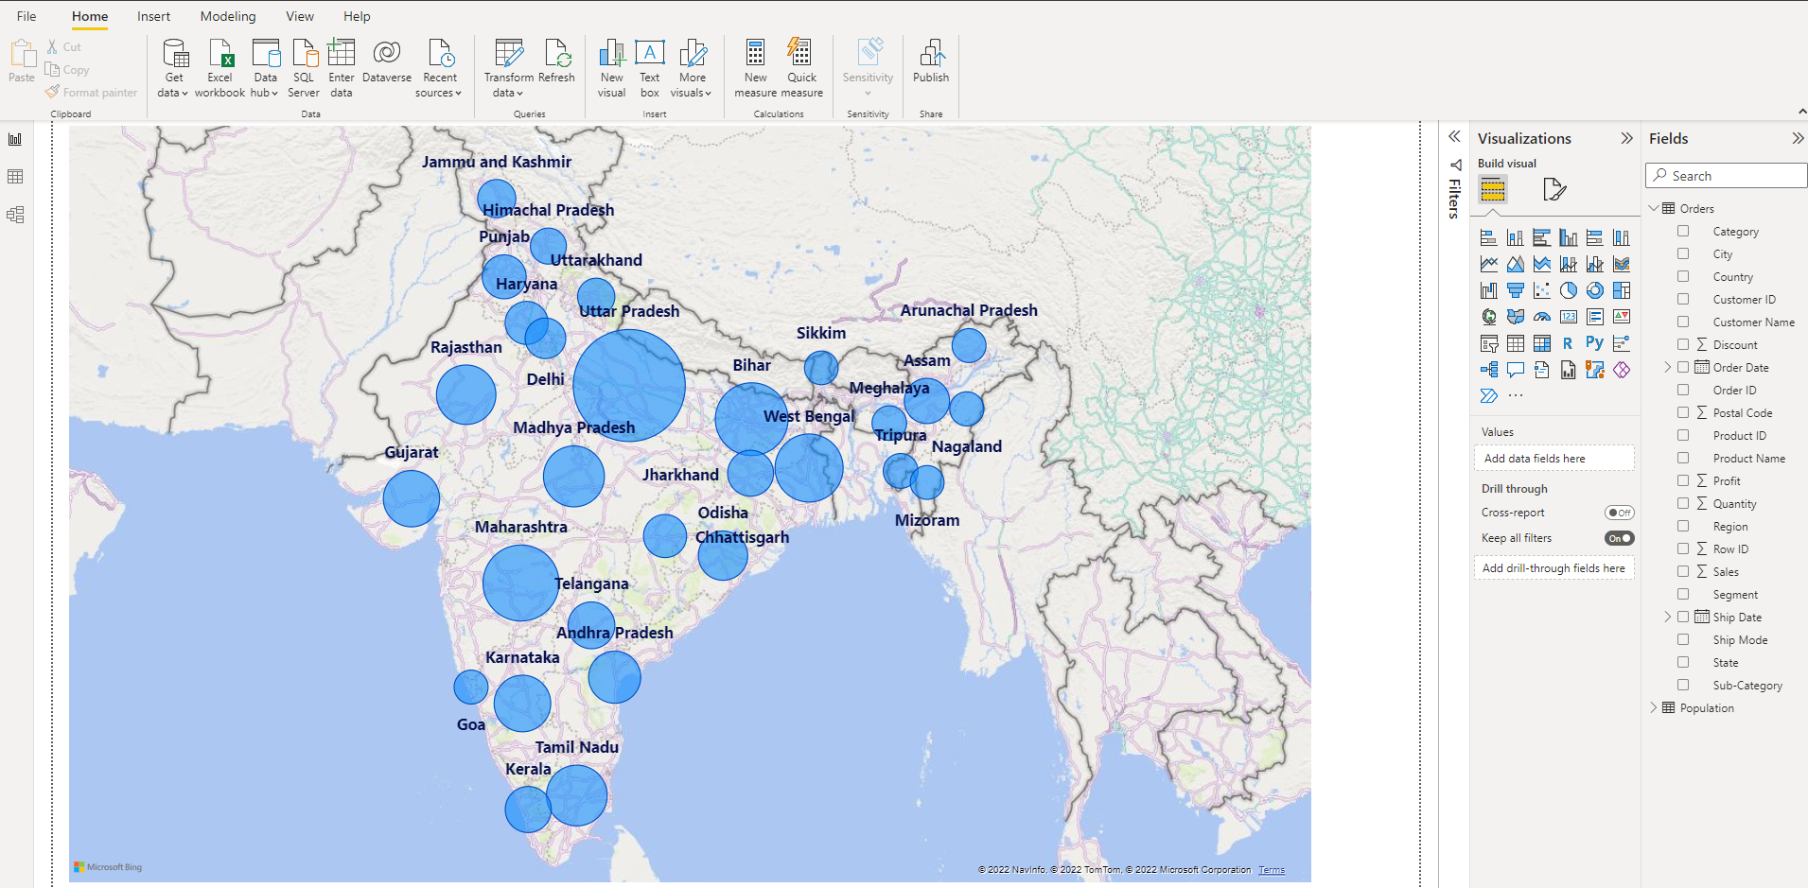
Map in Power BI - India Map

Slide 30
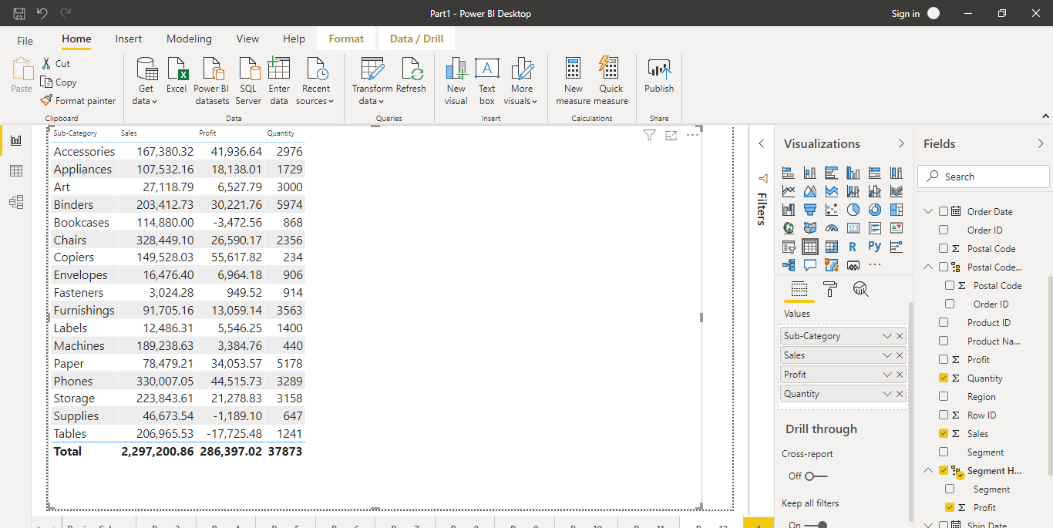
Tabular Data in Power BI - Tables
Use the Table under Visualizations and add the required fields in the Value box

Slide 31
Tabular Data in Power BI - Tables
Use the Table under Visualizations and add the required fields in the Value box

Slide 32
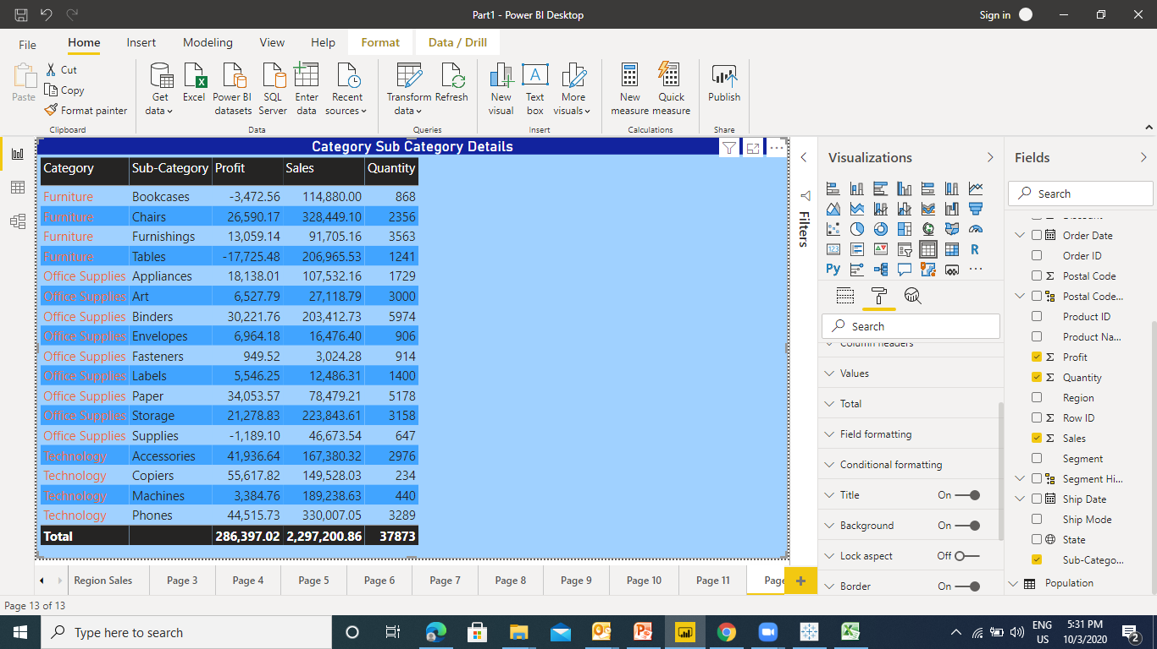
Tabular Data in Power BI -Formatting Tables
Changing the Font size : Values –> Text Size
Changing the Column Header Size : Column Headers –> Text Size
Adding Grid : Grid - > Vertical Grid / Horizontal Grid
Table Auto Format : Style -> Bold Header
Field Formatting
Back Ground Color
Add title

Slide 33
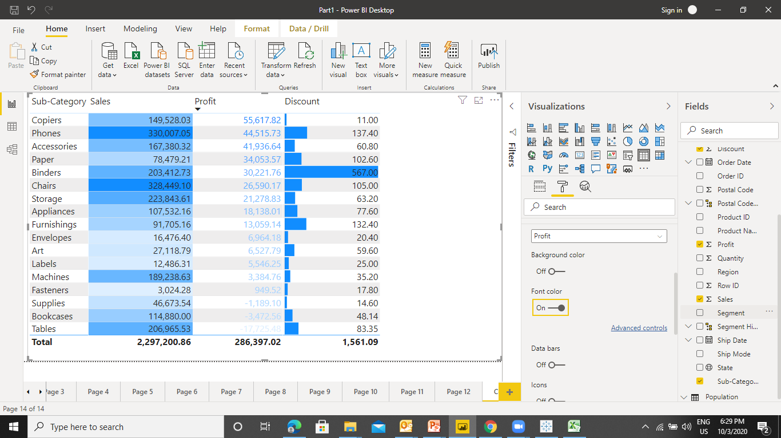
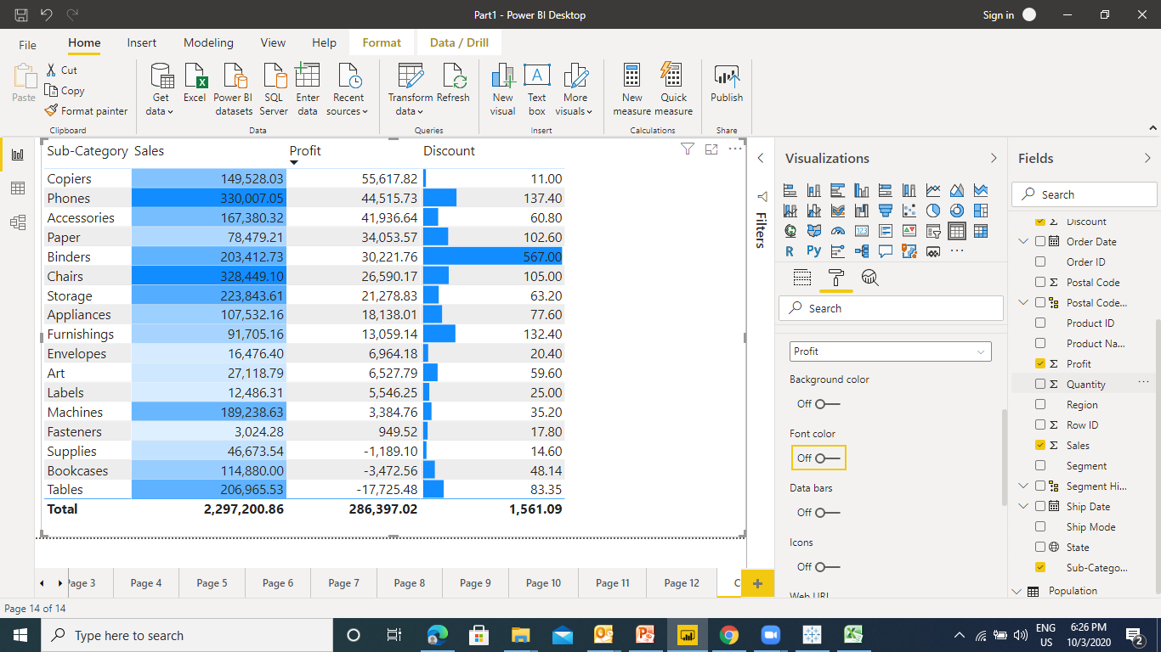
Tabular Data in Power BI -Conditional Formatting
Formatting the data based on the condition is known as Conditional Formatting

Slide 34
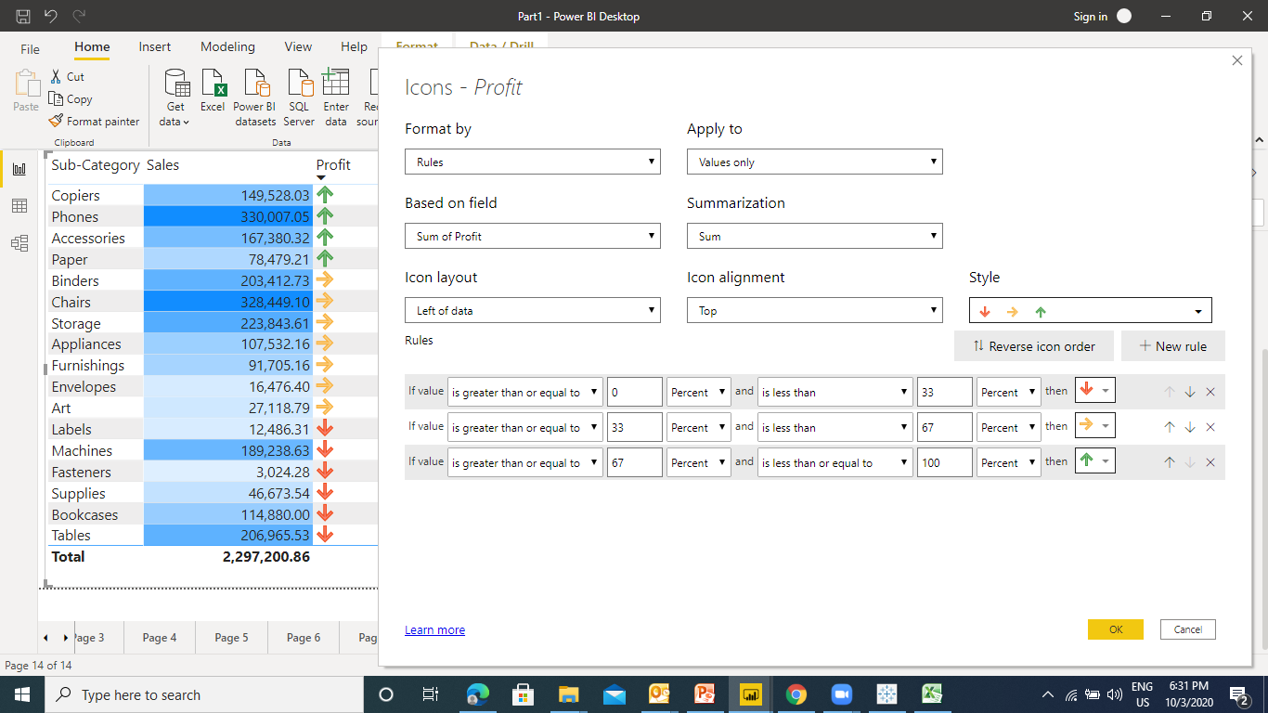
Tabular Data in Power BI -Conditional Formatting
Getting Icons

